Slide 1
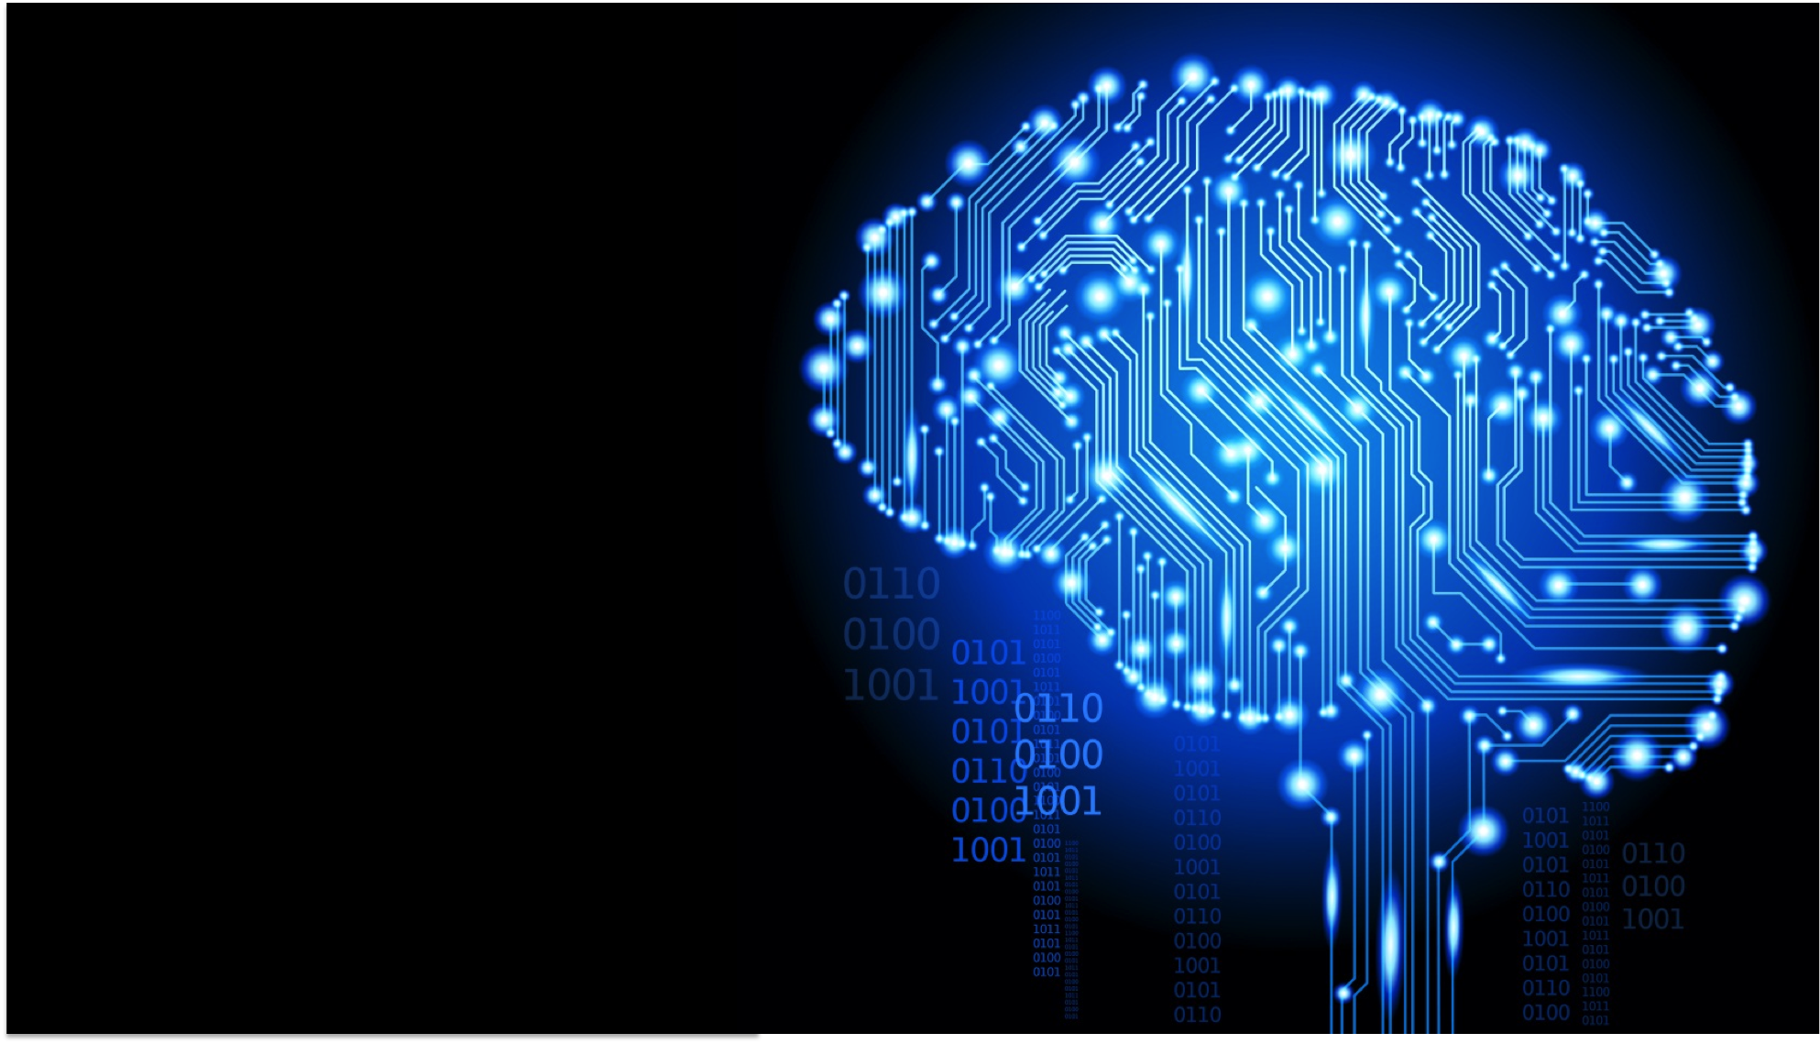
PedictHERS #ReWRITE
Mounika Gandavarapu
Radhika Bhati
Jayashree Subramanian
Meghna Prabhu
Athira Nam
Vipanchi Chacham
Notes:
What is deep learning?
In what fields is it useful, and how does it relate to artificial intelligence?
get a working understanding of deep learning
why is this powerful new technology is getting so much attention?
Learn how deep neural networks are trained to perform tasks with super-human accuracy.
What are the challenges organizations face in adopting this new approach.
We'll also cover the software, hardware, and training resources that many organizations are using to overcome the challenges and deliver breakthrough results.

Slide 2
“Innovation is creation of new and rearranging of old in a new way”

Slide 3
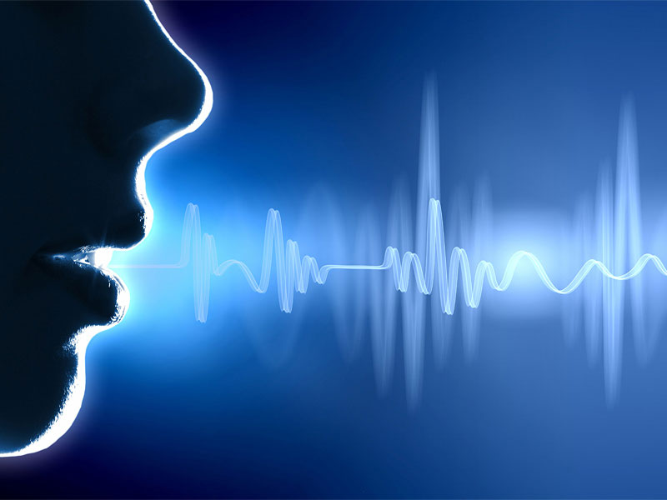
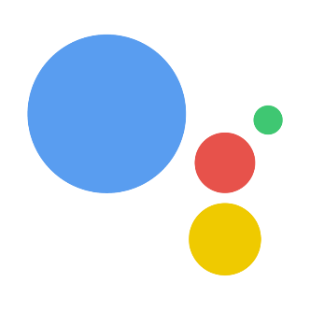
Automated Underwriting
Simplifying the form filling process in underwriting and recommending the desired insurance products based on company profile.
Google Assistant
Business Value-Add
Increasing number of clients per agent
Reduces the time
Improves efficiency
Eases the time-consuming process
Technologies Used
Chatbot AI
NLP
Google Home
Conversational UI

Slide 4
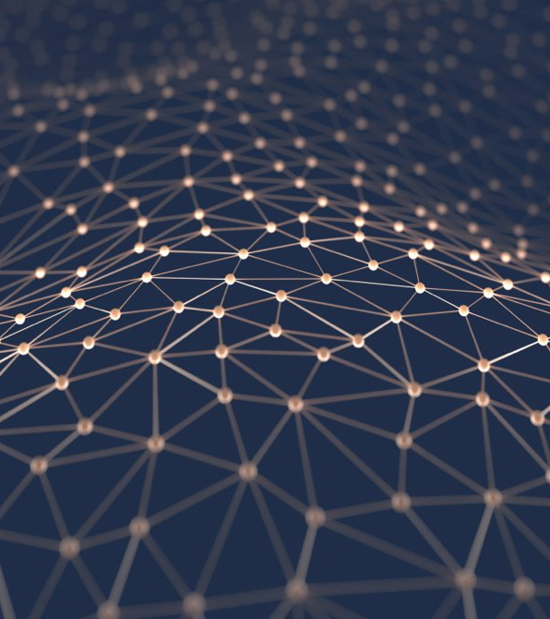
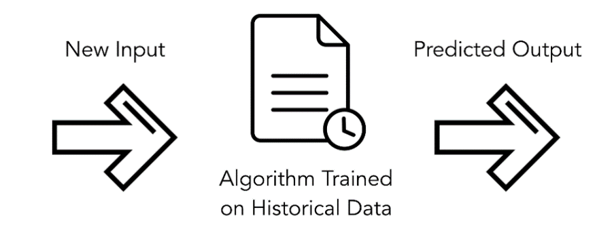
Predictive Modelling
A predictive machine learning model is built from the sensor data for alerting the customers with a warning SMS message and an email.
Business Value-Add
Dynamic
Automated
Predicts a hazard in prior and alerts the customers
Usage based Insurance (Pay-per-use)
Technologies Used
Python 3.0
Machine Learning
IoT (Sensor Data)
SMS/E-mail

Slide 5

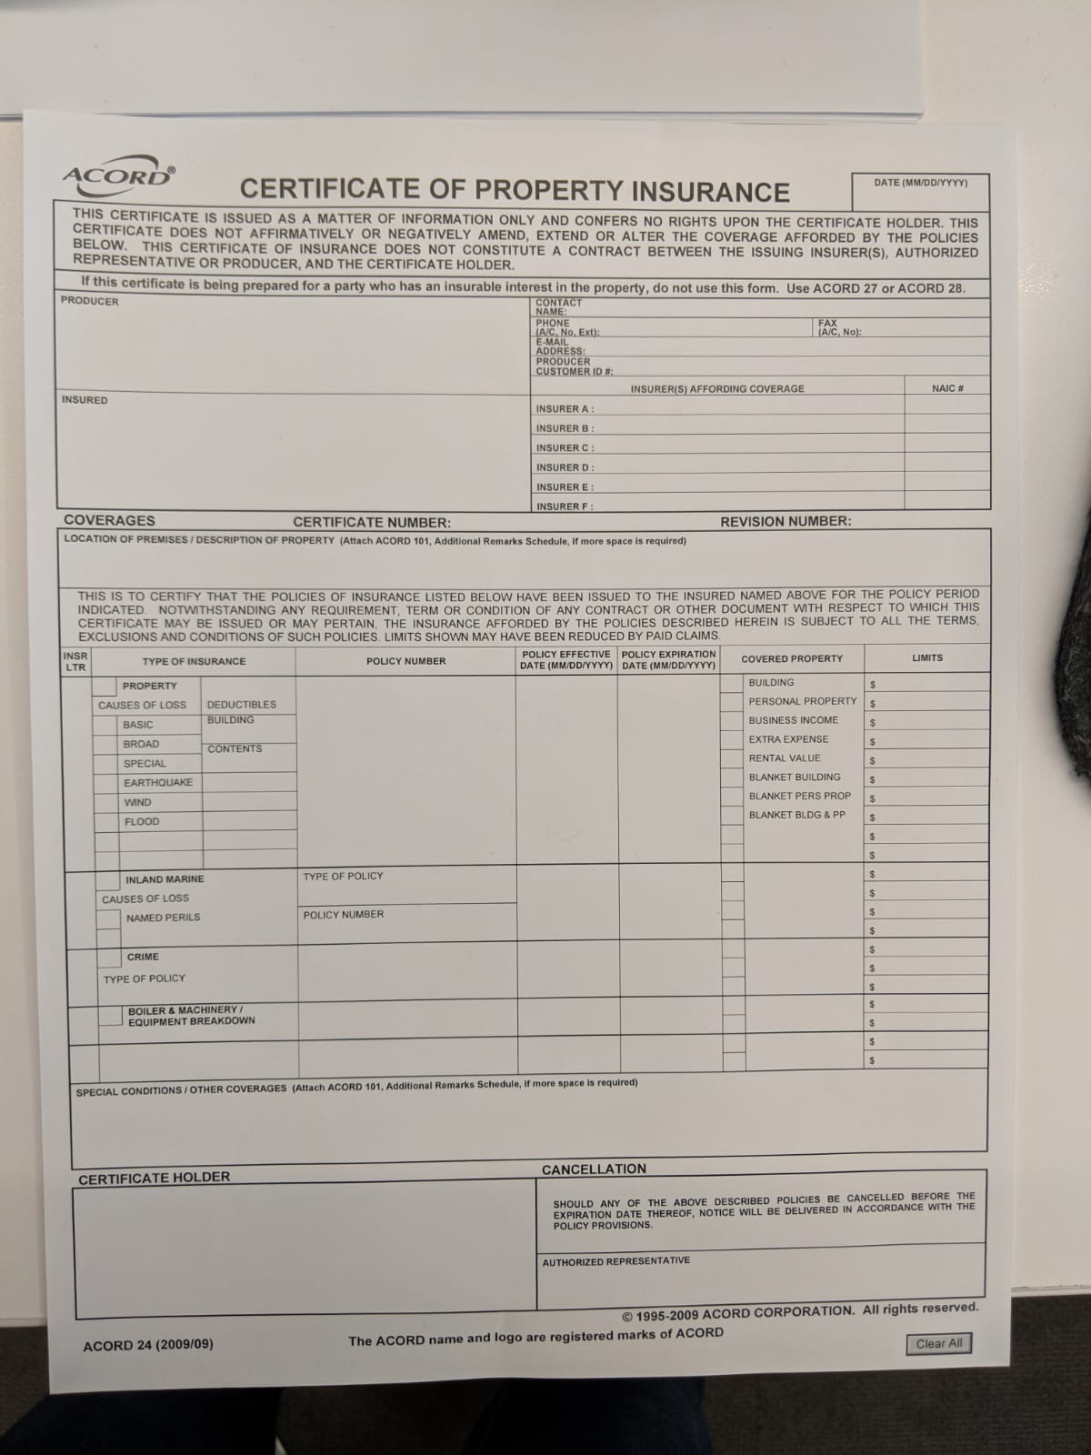
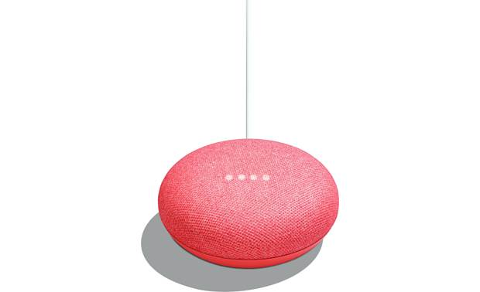

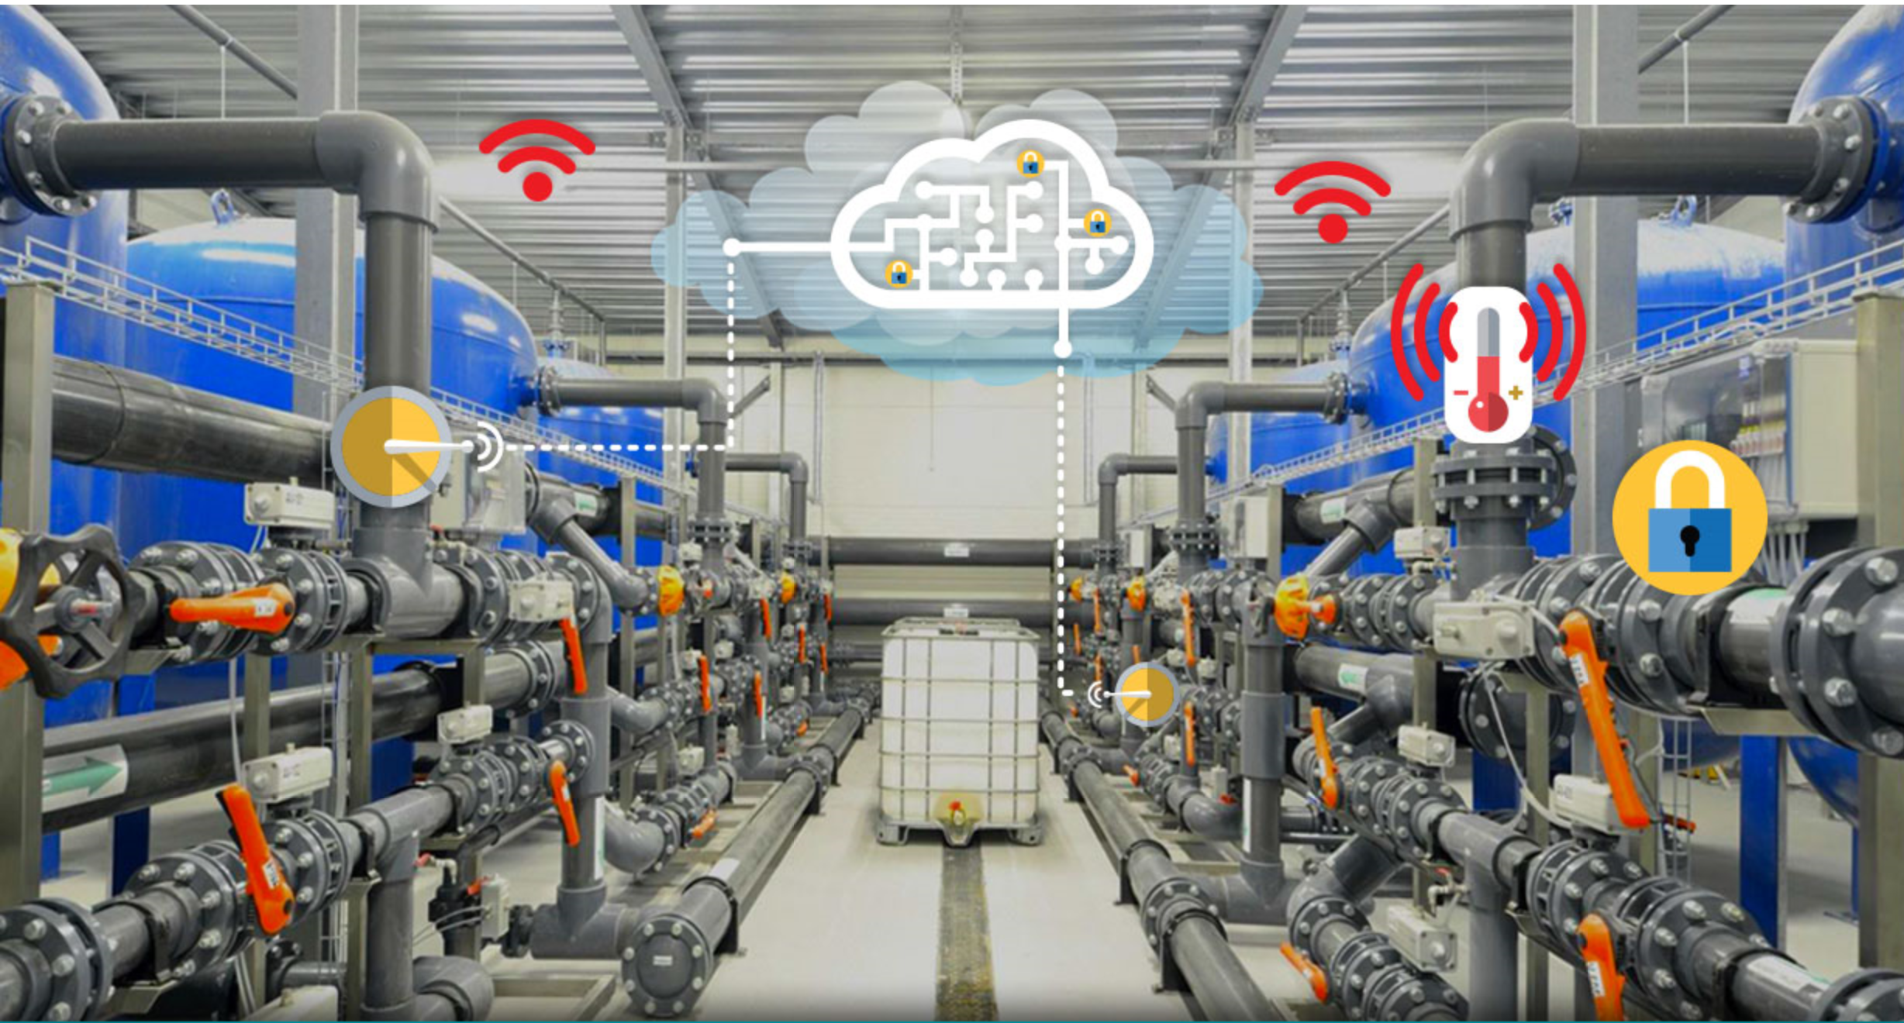



Proposed Methodology
Marsh Insurance Form
IoT Sensors
Data Analysis

Slide 6
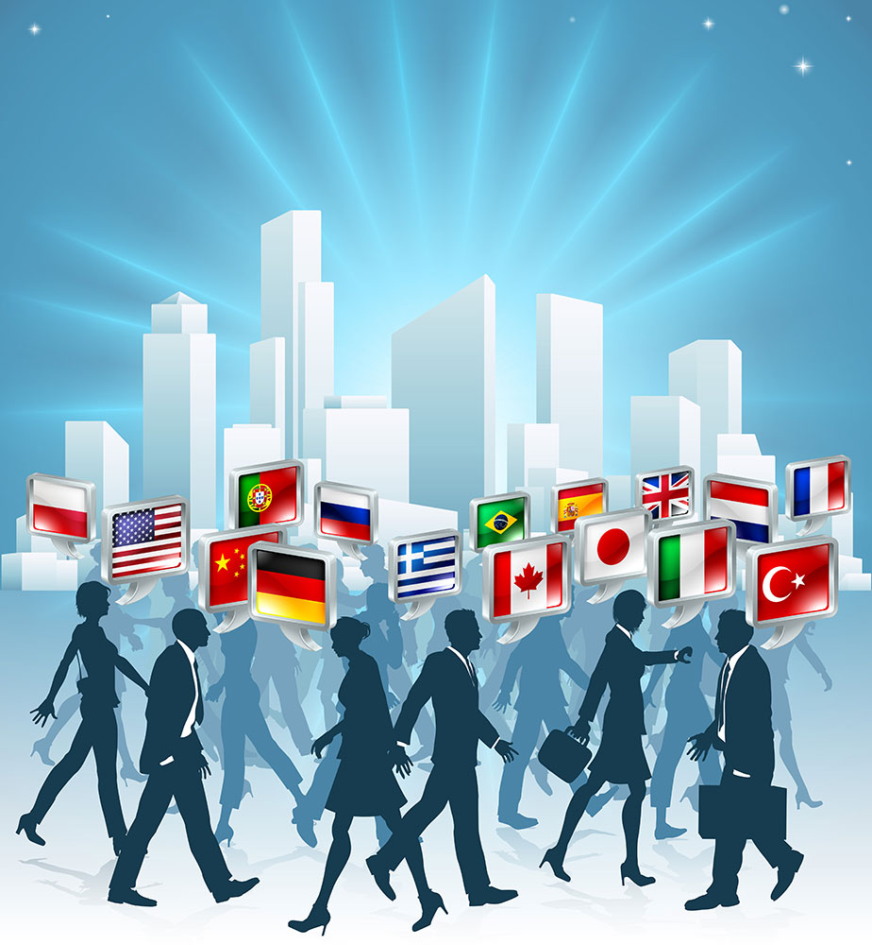
Business Model
Predict-hers - Benefits
No need to spend all the insurance money on companies
Additionally paid for sensor-prediction model
Builds trust and retains companies from withdrawing
Client - Benefits
Needn’t claim entire insurance
Saves property from destruction
Premium reduces if not used every year

Slide 7
Future Work
Extending it to all types of Hazards in all sectors
Automating end-to-end Underwriting process
Try with advanced Machine learning algorithms like Neural network, CNN, etc.
Expanding to different areas

